Slide 1

Learning on the edge
Fernanda Duhne
Based on the article from Adam Zewe (October 4, 2022)

Slide 2
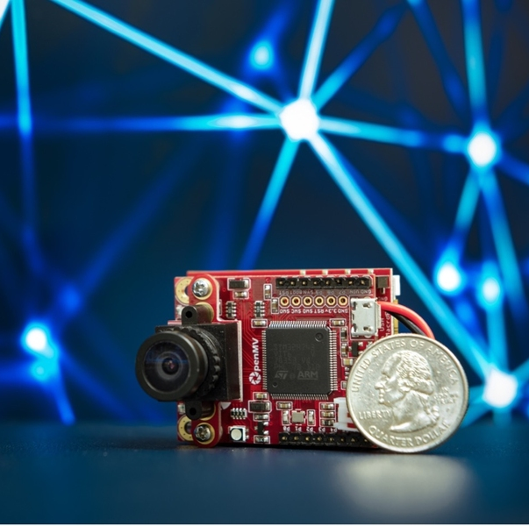
Relevant vocabulary
Microcontroller: compact integrated circuit designed to govern a specific operation in an embedded system
Includes a processor, memory and input/output peripherals on a single chip
Embedded system: combination of computer hardware and software designed for a specific function

Slide 3
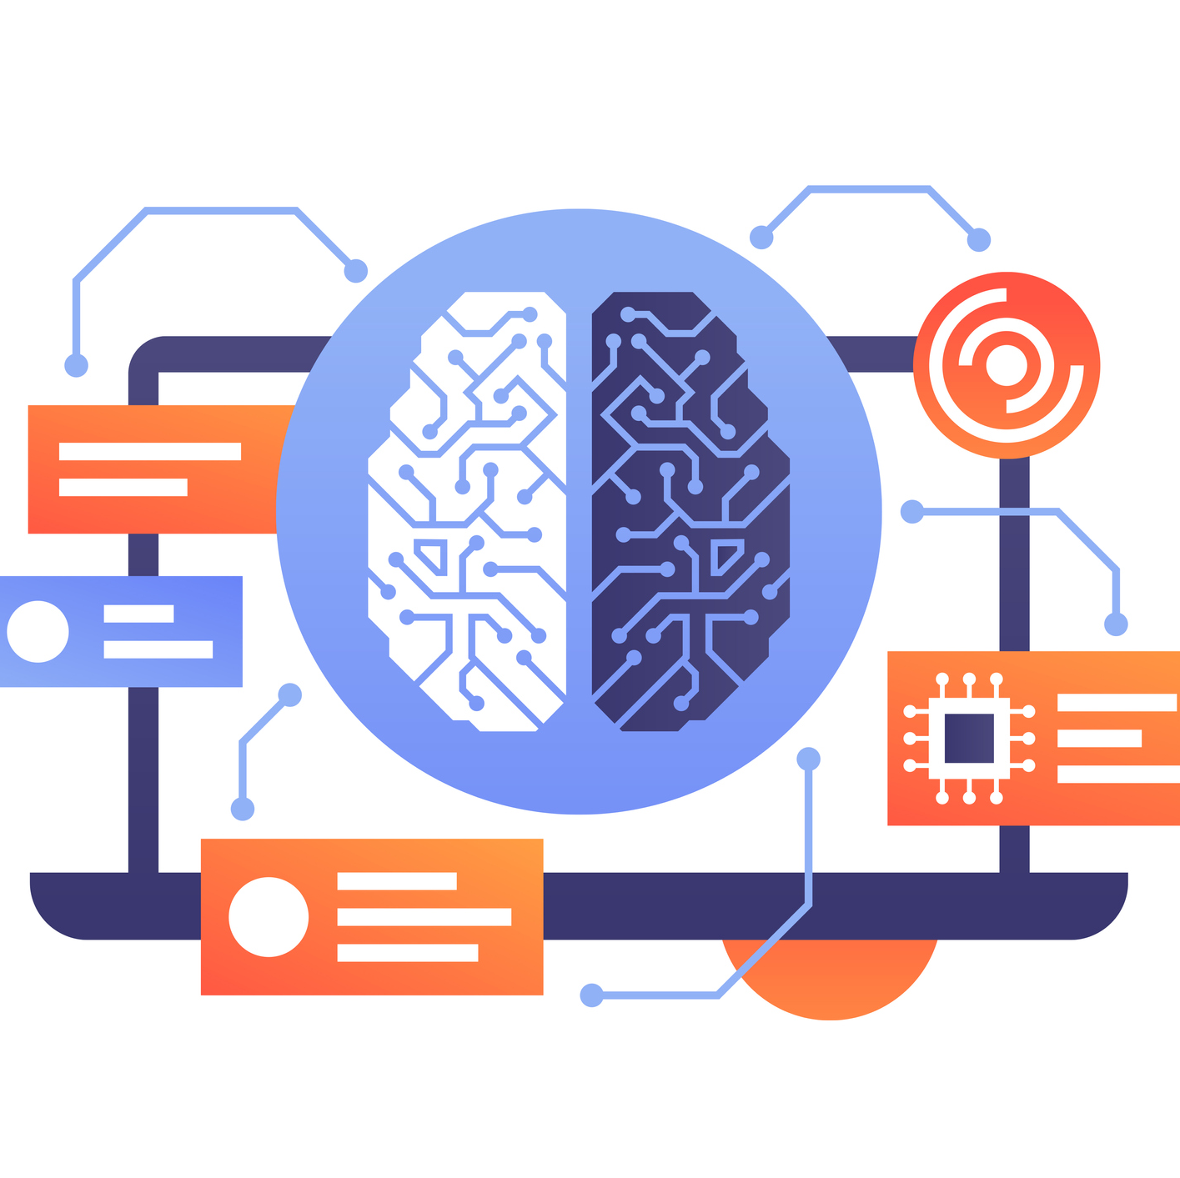
ML training
Training ML = adapt to new data = make better predictions.
The training process requires so much memory
Data center → deployed on a device
$
privacy issues
Notes:
Training a machine-learning model on an intelligent edge device allows it to adapt to new data and make better predictions.
The training process requires so much memory that it is typically done using powerful computers at a data center, before the model is deployed on a device.
This is more costly and raises privacy issues since user data must be sent to a central server.

Slide 4

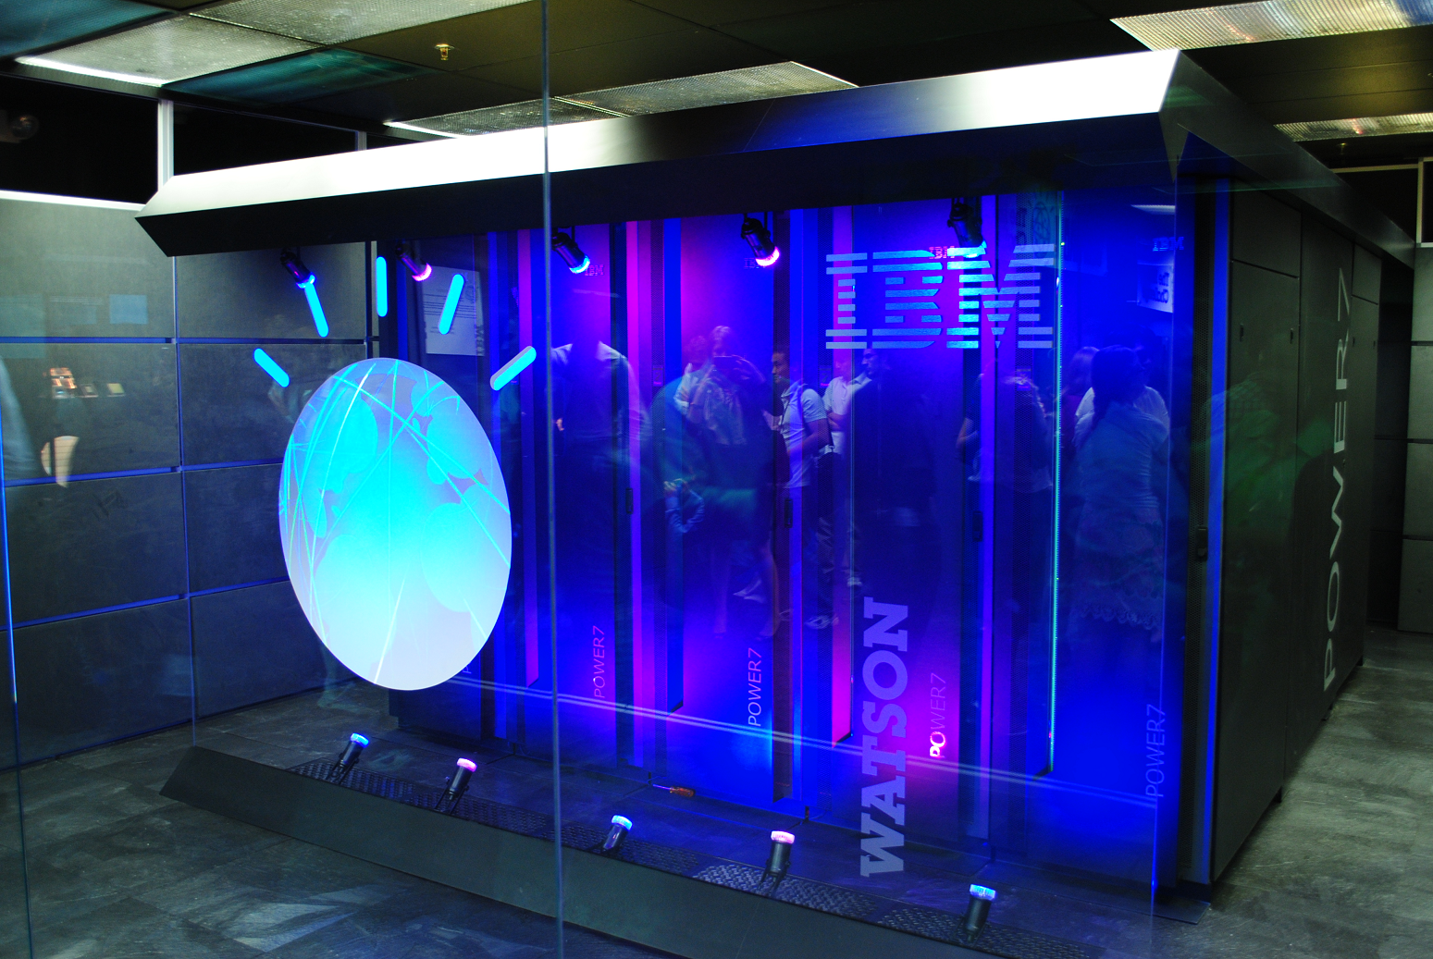
Normal capacity = 500 megabytes of memory
MIT-IBM Watson AI Lab developed a new technique
¼ of a megabyte
Microcontrollers capacity =
256 -kilobyte capacity
Notes:
The MIT-IBM Watson AI Lab developed a new technique that enables on-device training using less than a quarter of a megabyte of memory
Normally = 500 megabytes of memory, greatly exceeding the 256-kilobyte capacity of most microcontrollers
intelligent algorithms and framework the researchers developed reduce the amount of computation required to train a model, which makes the process faster and more memory efficient
Different microcontrollers have different memory capacity, usually in two components:
ROM: It stores the application program in the microcontroller. Bigger the size, the more complex it becomes.
RAM: It usually performs two functions i.e. reads and writes to the stored data. Additionally, it holds the data to be analyzed by the processor and take an action.

Slide 5

TinyML initiative
Preserves privacy, keep data on device
Data sensitive situations, e.g., medical applications.
Enable customization
Address memory and computational bottlenecks of ML
Notes:
technique also preserves privacy by keeping data on the device, which could be especially beneficial when data are sensitive, such as in medical applications.
enable customization
The research will be presented at the Conference on Neural Information Processing Systems
team previously addressed the memory and computational bottlenecks that exist when trying to run machine-learning models on tiny edge devices, as part of their TinyML initiative

Slide 6
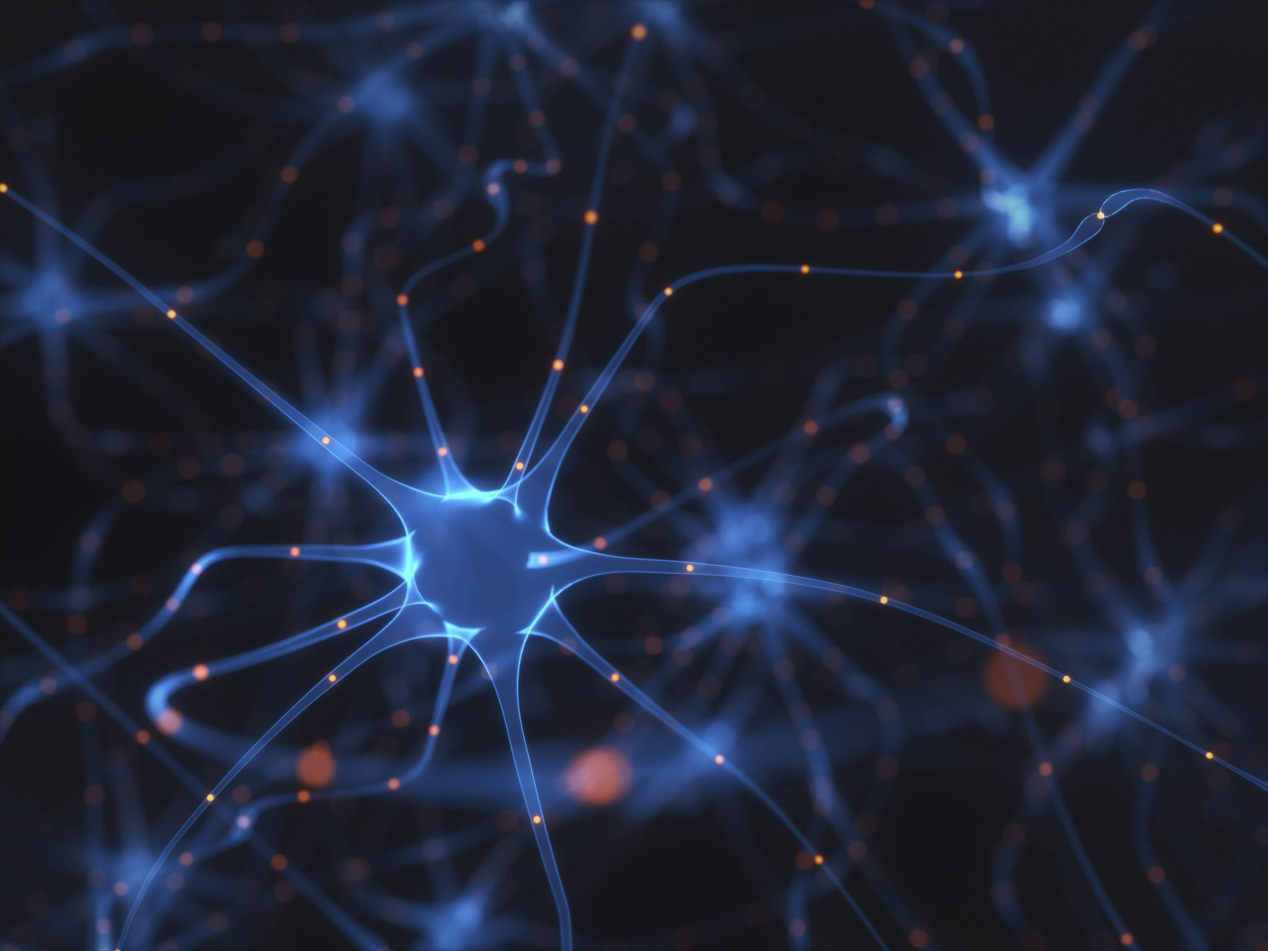
Neural network
A common type of machine-learning model
Layers of interconnected nodes/neurons that process data to complete a task
Train the model = showing it millions of examples
Learns → increases or decreases the strength of the connections between neurons, known as weights.
Notes:
A common type of machine-learning model is known as a neural network. Loosely based on the human brain, these models contain layers of interconnected nodes, or neurons, that process data to complete a task, such as recognizing people in photos
The model must be trained first, which involves showing it millions of examples so it can learn the task. As it learns, the model increases or decreases the strength of the connections between neurons, which are known as weights.

Slide 7
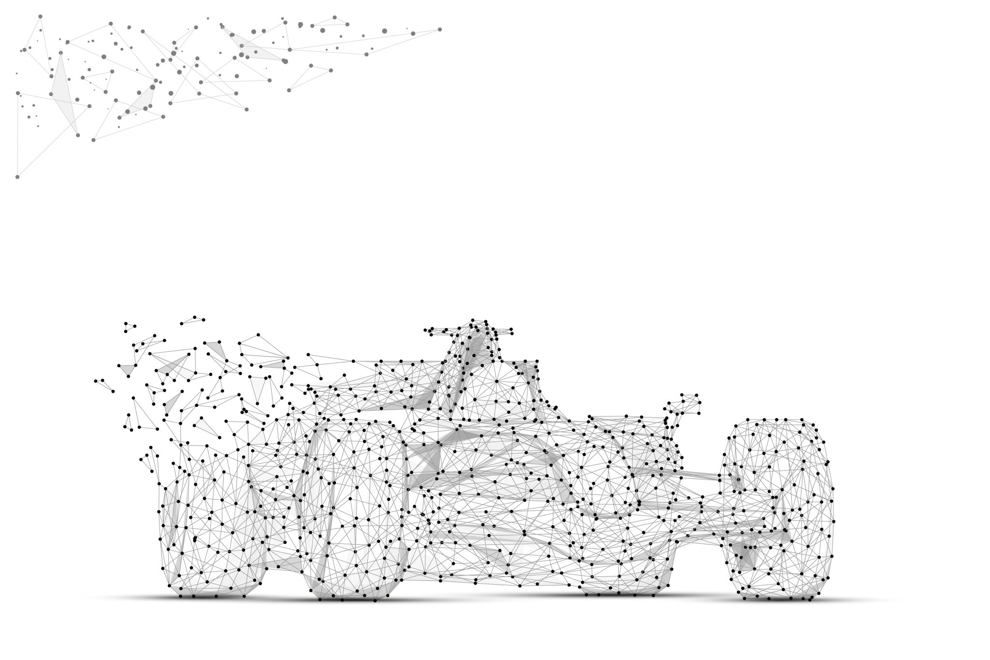
Two algorithmic solutions
Notes:
"Threshold" just means a tipping point in some calculation
employed two algorithmic solutions to make the training process more efficient and less memory-intensive.

Slide 8

Sparse update
The algorithm identifies the most important weights
Freeze the weights one at a time until accuracy
The remaining weights are updated
Frozen weights = not stored
Selectively update weights to preserve accuracy
Notes:
sparse update, uses an algorithm that identifies the most important weights to update at each round of training.
The algorithm starts freezing the weights one at a time until it sees the accuracy dip to a set threshold, then it stopsThe remaining weights are updated, while the activations corresponding to the frozen weights don’t need to be stored in memory.
we selectively update those important weights and make sure the accuracy is fully preserved,

Slide 9
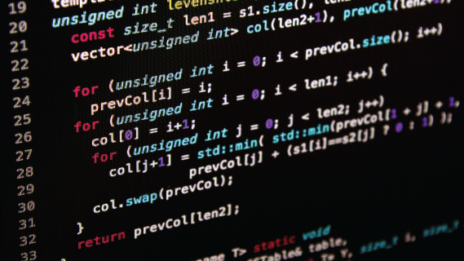
Quantized training and simplifying the weights (32 bits)
Quantization: an algorithm rounds the weights → 8 bits
Reduce memory
Training
Inference (process of applying a model to a dataset and generating a prediction)
Quantization-aware scaling (QAS): adjust the ratio between weight and gradient(like a multiplier) to avoid drop in accuracy
Notes:
quantized training and simplifying the weights, which are typically 32 bits.
An algorithm rounds the weights so they are only eight bits, through a process known as quantization, which cuts the amount of memory for both training and inference (process of applying a model to a dataset and generating a prediction)
Then the algorithm applies a technique called quantization-aware scaling (QAS), which acts like a multiplier to adjust the ratio between weight and gradient, to avoid any drop in accuracy that may come from quantized training.

Slide 10

This system changes the order of steps in the training process, so more work is completed in the compilation stage, before the model is deployed on the edge device.
Notes:
tiny training engine: system that can run these algorithmic innovations on a simple microcontroller that lacks an operating system
This system changes the order of steps in the training process so more work is completed in the compilation stage, before the model is deployed on the edge device.

Slide 11

Other techniques
300 and 600 megabytes
157 kilobytes of memory to train a machine-learning model on a microcontroller
Test:
Train computer vision model to detect people in images.
10 minutes of training
20 times faster than other approaches
Notes:
Their optimization only required 157 kilobytes of memory to train a machine-learning model on a microcontroller, whereas other techniques designed for lightweight training would still need between 300 and 600 megabytes.
They tested their framework by training a computer vision model to detect people in images. After only 10 minutes of training, it learned to complete the task successfully. Their method was able to train a model more than 20 times faster than other approaches.

Slide 12
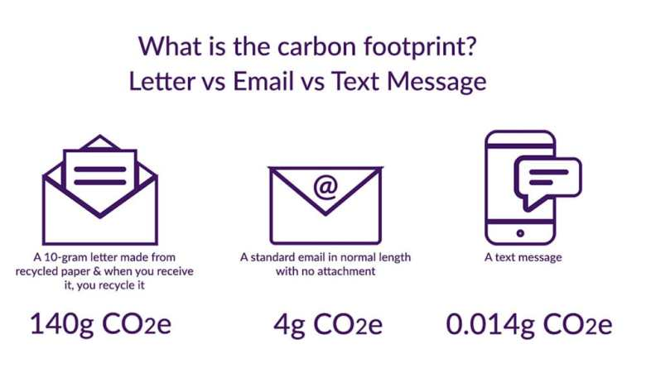
Application
Language models and different types of data
Time-series data
Shrink the size of larger models without sacrificing accuracy
Reduce the carbon footprint of training large-scale machine-learning models.
Notes:
the researchers want to apply them to language models and different types of data, such as time-series data
shrink the size of larger models without sacrificing accuracy, which could help reduce the carbon footprint of training large-scale machine-learning models.

Slide 13
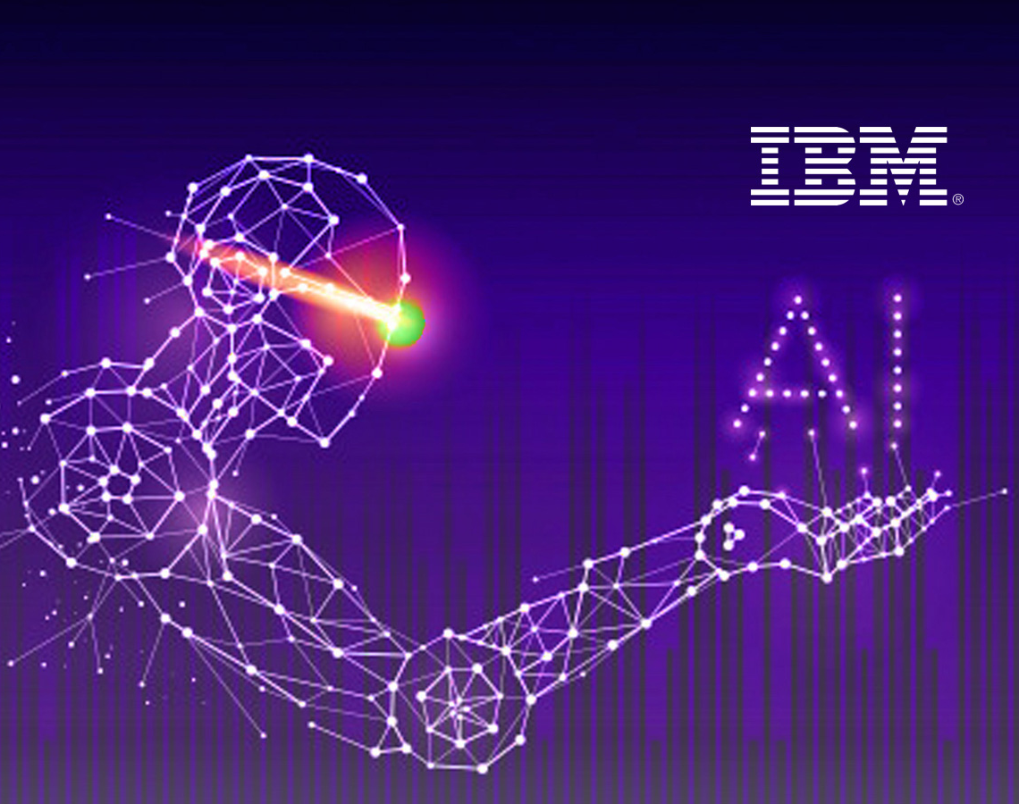
Summary
AI models continually learn from new data on intelligent edge devices like smartphones and sensors, reducing energy costs and privacy risks.

Slide 14
Reference
Zewe, Adam. Learning on the edge https://news.mit.edu/2022/machine-learning-edge-microcontroller-1004 October 4, 2022
Full article: https://arxiv.org/pdf/2206.15472.pdf

